Slide 1

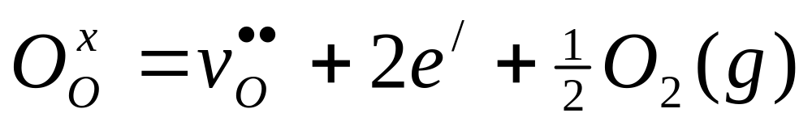
KJM5120 and KJM9120 Defects and Reactions
Ch 2. Defect reactions
Truls Norby

Slide 2
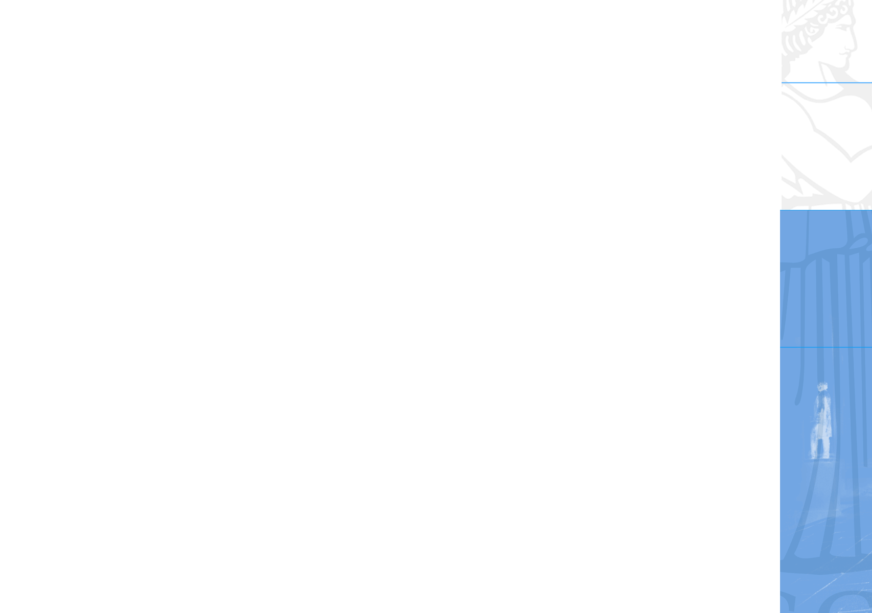
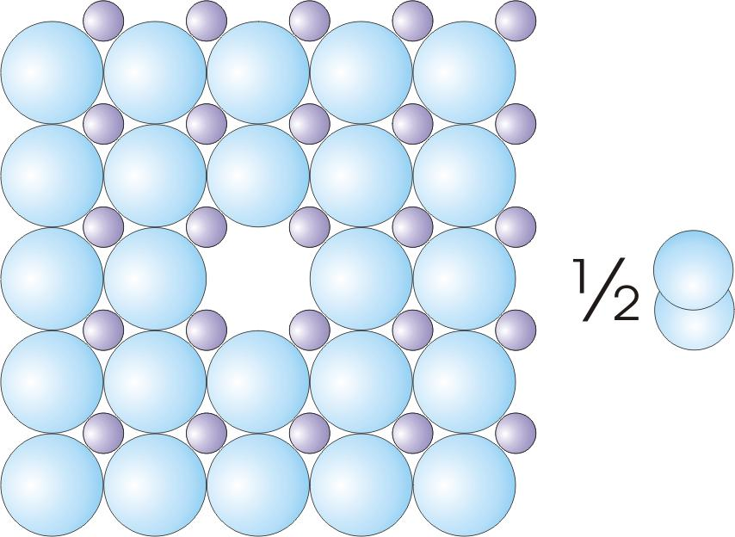
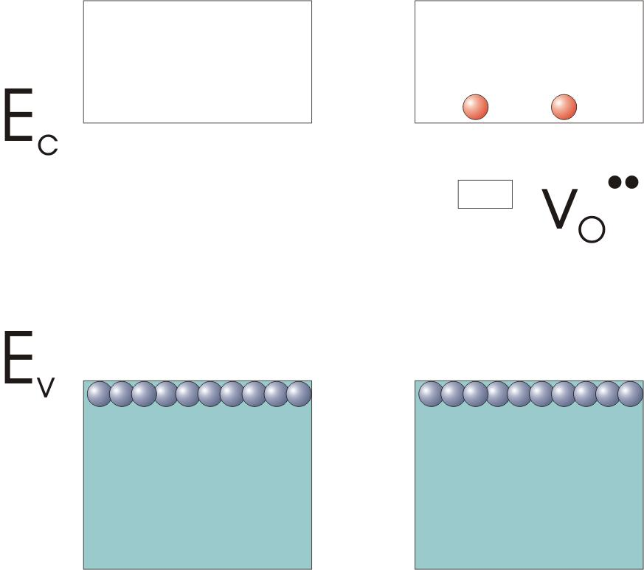
Defect reactions - approach
The main aim of this chapter is to learn to formulate and balance chemical reaction equations for defects
The compendium chapter has the rules and many examples of reactions and equations. By this, you learn by examples and also get to know defects and combinations (uaually pairs) of defects better.
In this presentation we will add illustrations of what goes on schematically in the structure.
We will also add illustrations of what goes on in the electron energy band structure during defect reactions.
First, however, we take a few slides to warm up for the three rules….

Slide 3
Some concepts of defect chemical reactions
The following slides are a couple of examples that will give us some concepts and ideas of what we are going to learn. They are additional to the treatment in the compendium.
If you find them difficult to follow, don’t worry, you don’t have to understand them, yet. We will learn how to do it later on.
But look at them and take in the comments that are provided….
We will arbitrarily use zinc oxide ZnO as example here, just for variation ☺

Slide 4
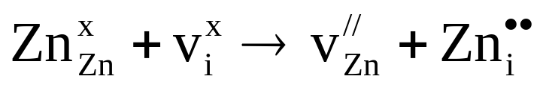
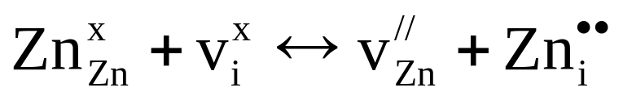
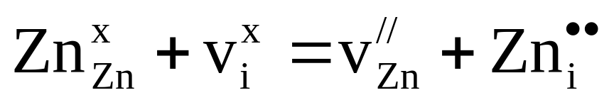
Defect chemical reaction
Simple example….use of symbols
Formation of cation Frenkel defect pair in zinc oxide, ZnO:
Reaction
Equilibrium
Use of = for simplicity and
for not differentiating between
reaction and equilibrium

Slide 5
Defect chemical reaction
Simple example….balances are easy
Formation of cation Frenkel defect pair in zinc oxide, ZnO:
The reaction takes a zinc ion and an empty interstitial site, puts the zinc ion on that empty site and leaves the zinc’s original site empty. We get a zinc vacancy and a zinc interstitial.
We notice that normal chemical mass balance is maintained (one Zn before, one Zn after).
We notice that charge is also maintained; it was effectively neutral before, and is in sum effectively neutral afterwards.
Finally, we notice that the sites are the same before and after.

Slide 6
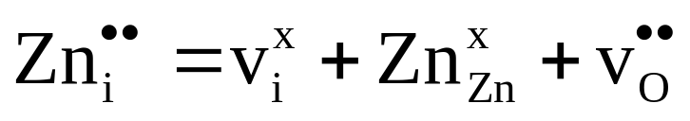
Defect chemical reaction
Another example…less obvious
Replace a zinc interstitial with an oxygen vacancy:
Here a zinc interstitial makes a new zinc ion site, and an oxygen vacancy is formed also, but remains empty.
We notice that normal chemical mass balance also here is maintained (one Zn before, one Zn after).
Charge is maintained but not neutral: It was effectively positive before and it is effectively positive after; The equation can have net charge (the same) on both sides.
Finally, we notice that new sites are formed: One new Zn and one new O site. The crystal has changed the number of sites, but the ratio 1:1 of the ZnO host crystal structure is maintained.

Slide 7
Three rules for writing and balancing defect chemical reaction equations
Mass balance: Conservation of mass
Charge balance: Conservation of charge
Site ratio balance: Conservation of host structure

Slide 8
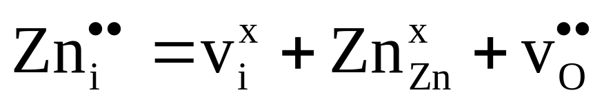
Mass balance – conservation of mass
applied on the same two equations we have been looking at:
Atoms are conserved
Vacancies are empty and do not enter in the mass balance.
Electrons are commonly not counted in mass balance.

Slide 9
Charge balance – conservation of charge
Charge (zero charge or net charge) is conserved
Counted in terms of effective charges or real charges. Don’t mix!

Slide 10
Site ratio balance – conservation of the host structure
Sites may be kept, or they may be formed or annihilated. If they are formed or annihilated, the addition or subtraction of sites must be in the ratio of sites of the host structure. Conserve the host structure!
In this course we will often keep track also of use of interstitial sites, but we will not apply the rule much to them…it rarely matters.
Form one of each site in ZnO

Slide 11
Examples of important defect chemical reactions
Now we move on to do some defect reactions by the rules.
Check if the three rules are obeyed.

Slide 12
Stoichiometric compounds – intrinsic disorders
Disorders that do not exchange mass with the surroundings, and thus do not affect the stoichiometry of the compound.

Slide 13
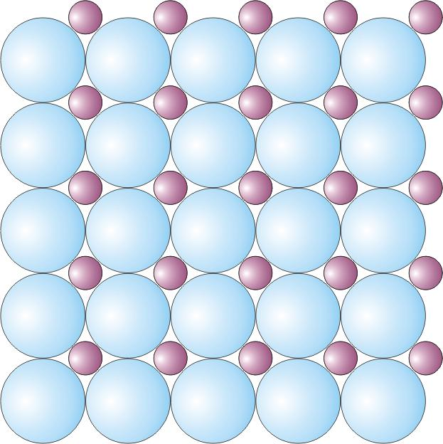
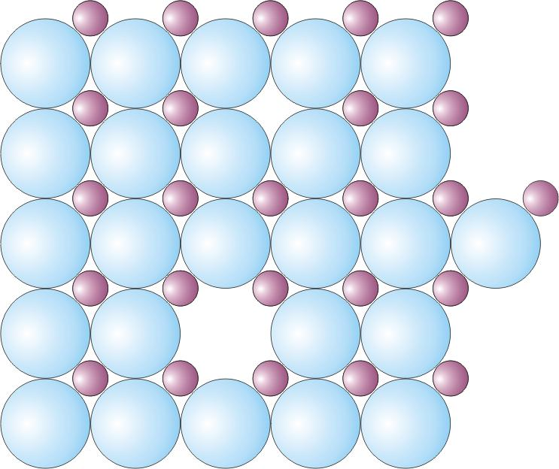
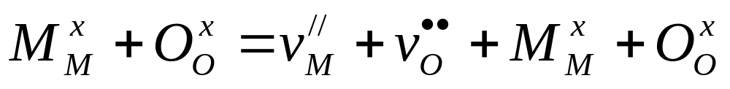
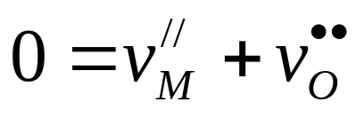
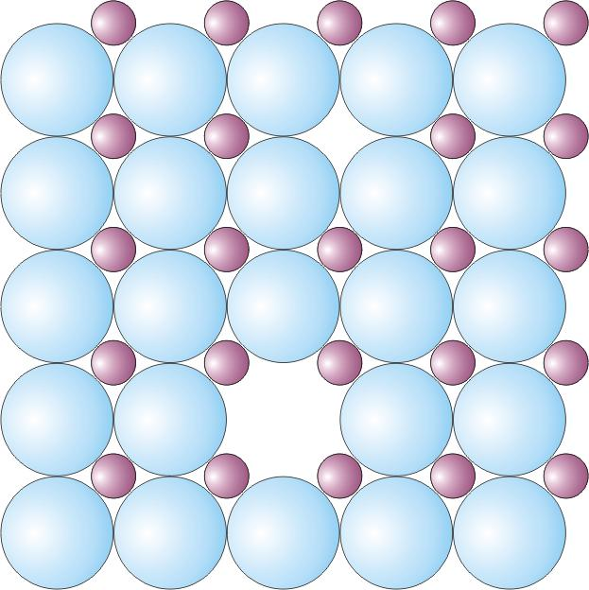
Schottky disorder in MO
M²⁺
new structural unit
O²⁻
or, equivalently:

Slide 14
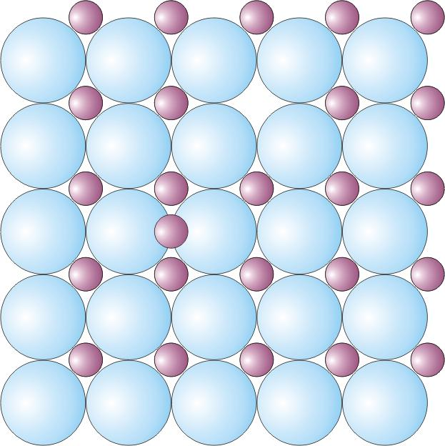
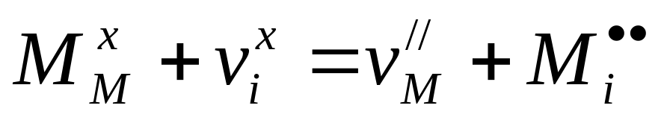
Frenkel disorder in MO
M²⁺
O²⁻

Slide 15
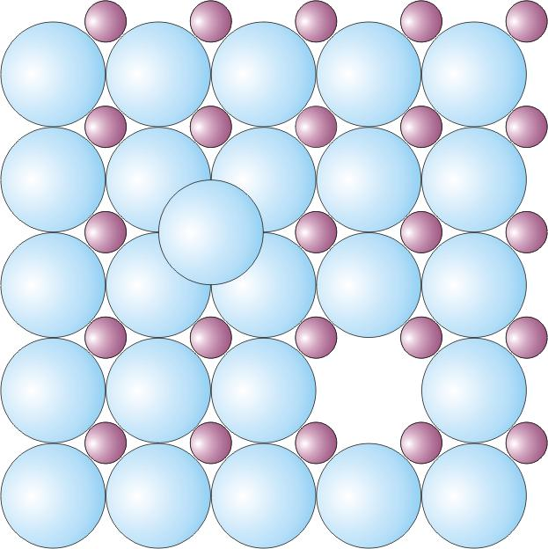
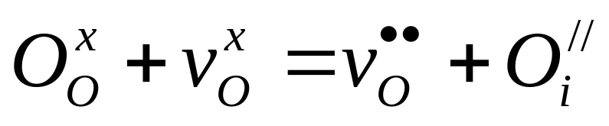
Anion (anti-)Frenkel disorder in MO
M²⁺
O²⁻

Slide 16
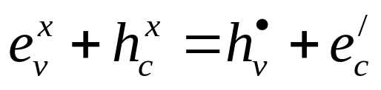
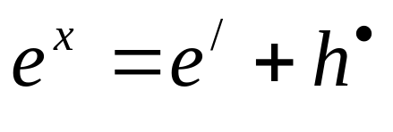
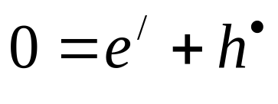
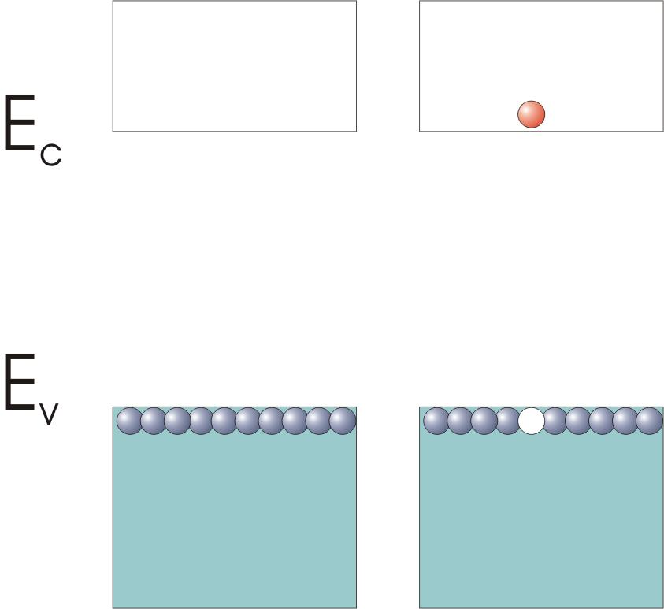
Intrinsic electronic ionisation
Three equivalent reaction equations:
Consider charges, electrons and sites:
Simpler; skip sites:
Simplest; skip valence band electrons:

Slide 17
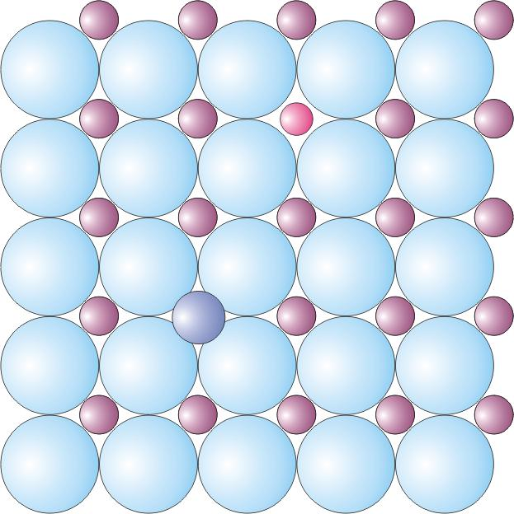
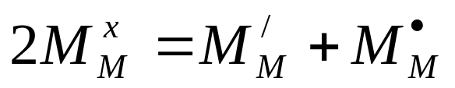
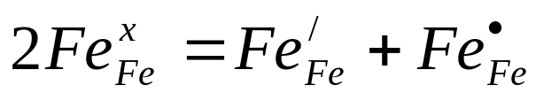
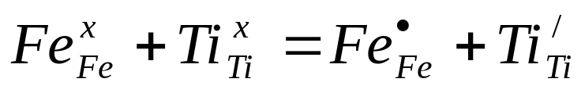
Valence defects – localised electrons and holes
Example: Fe₂O₃
Example: Ilmenite FeTiO₃

Slide 18
Nonstoichiometric compounds – exchange of components with the surroundings
Disorders that exchange mass of one of the components with the surroundings, and thus change the stoichiometry of the compound.
We will take the first one – oxygen deficiency – in small steps, then the other one more briefly.

Slide 19
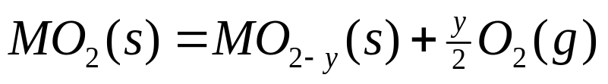
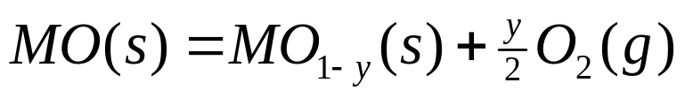
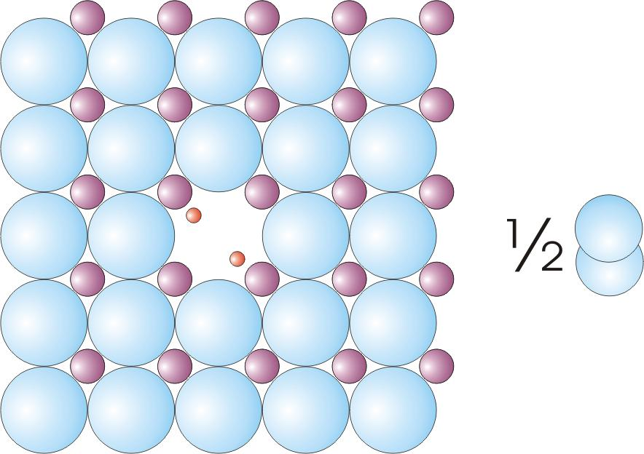
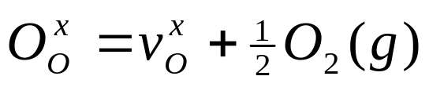
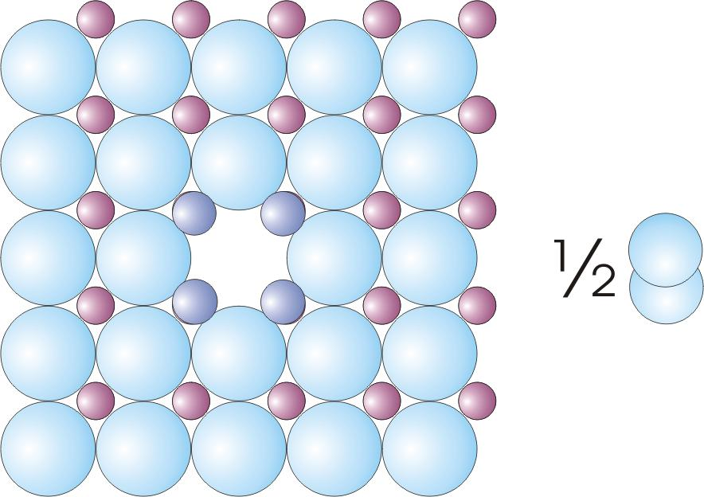
Oxygen deficiency
“Normal” chemistry:
The two electrons of the O²⁻ ion are shown left behind
Defect chemistry:
More realistic picture, where the two electrons are delocalised on neighbouring cations

Slide 20
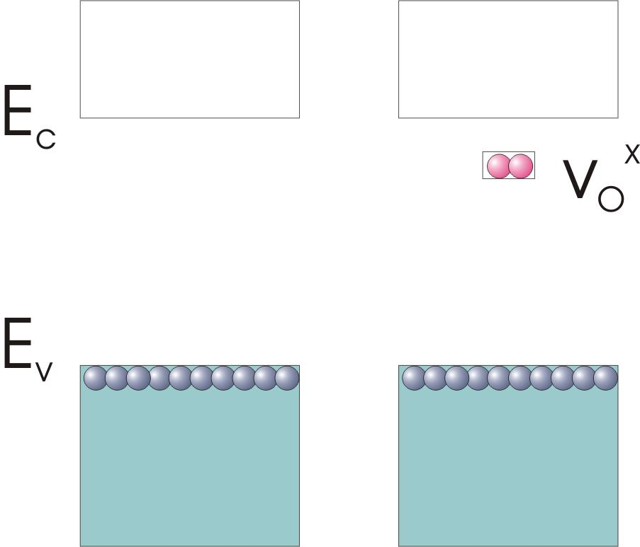
Oxygen deficiency
The two electrons of the O²⁻ ion are shown left behind
The two electrons are loosely bonded since the nuclear charge of the former O²⁻ ion is gone. They get a high energy close to the state of the reduced cations…the conduction band. The vacancy is a donor.

Slide 21
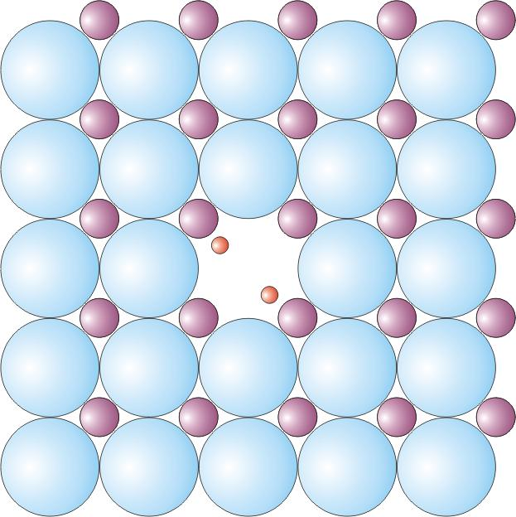
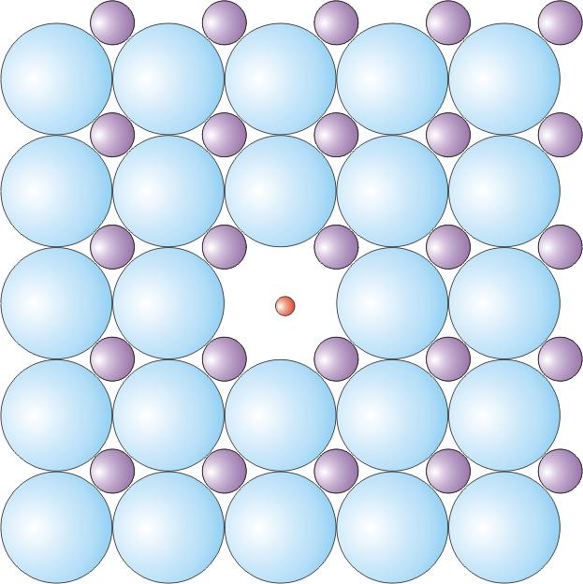
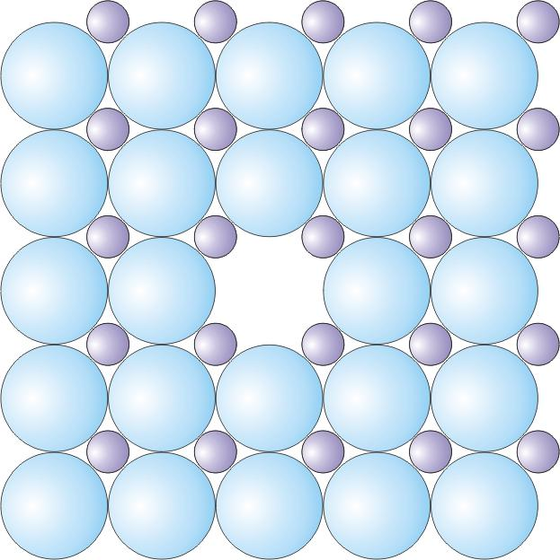
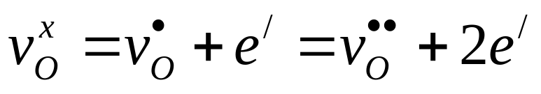
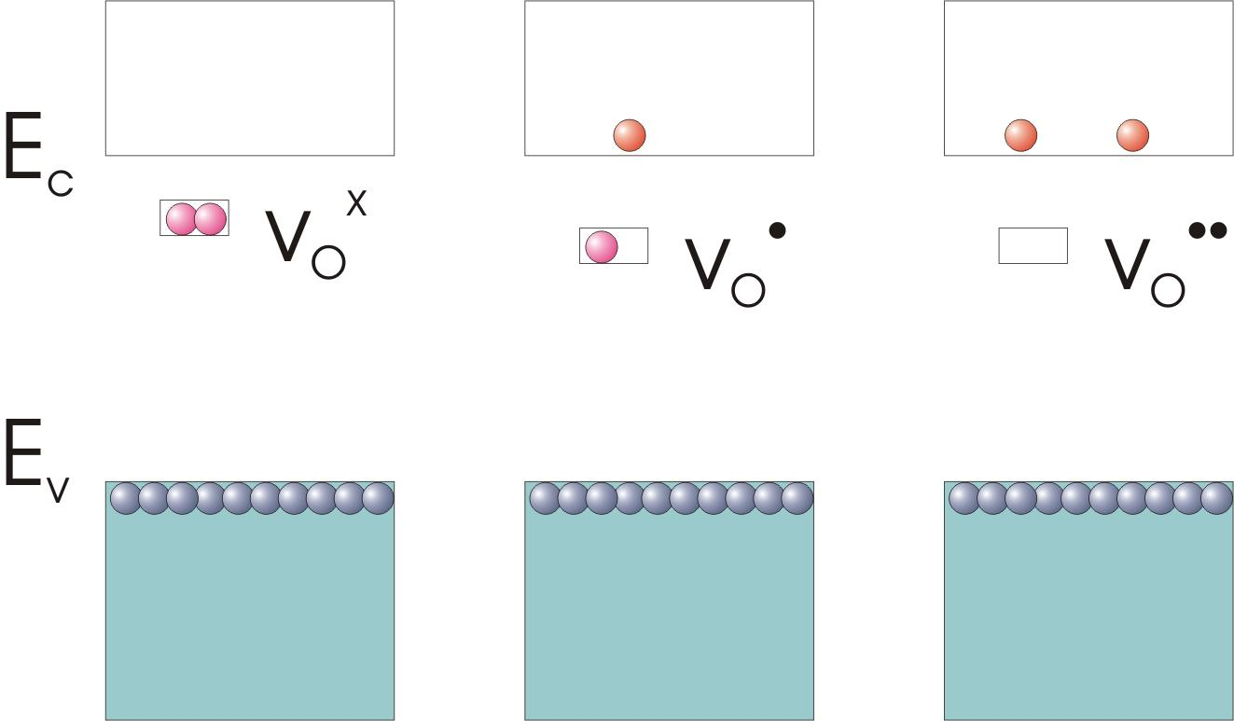
Ionisation of the oxygen vacancy donor
Electrons excited to conduction band delocalised over entire crystal, mainly in orbitals of reduced cation

Slide 22
Oxygen deficiency – overall reaction

Slide 23
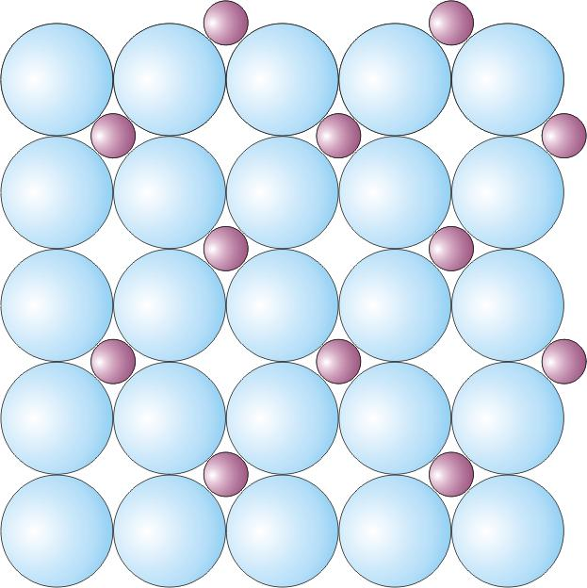
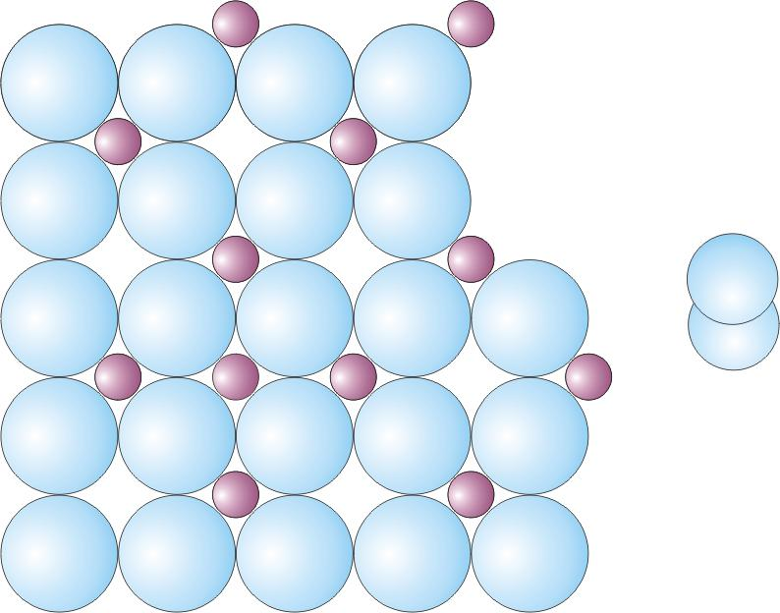
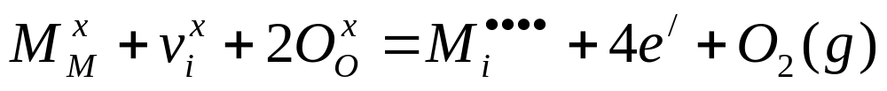
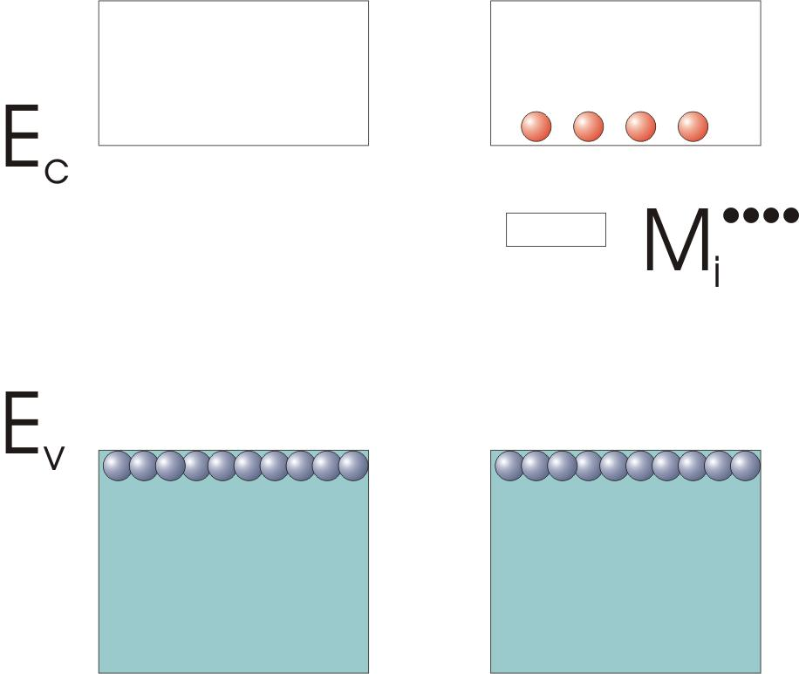
Metal excess
Metal interstitials, example MO₂ - M_{1+x}O₂

Slide 24
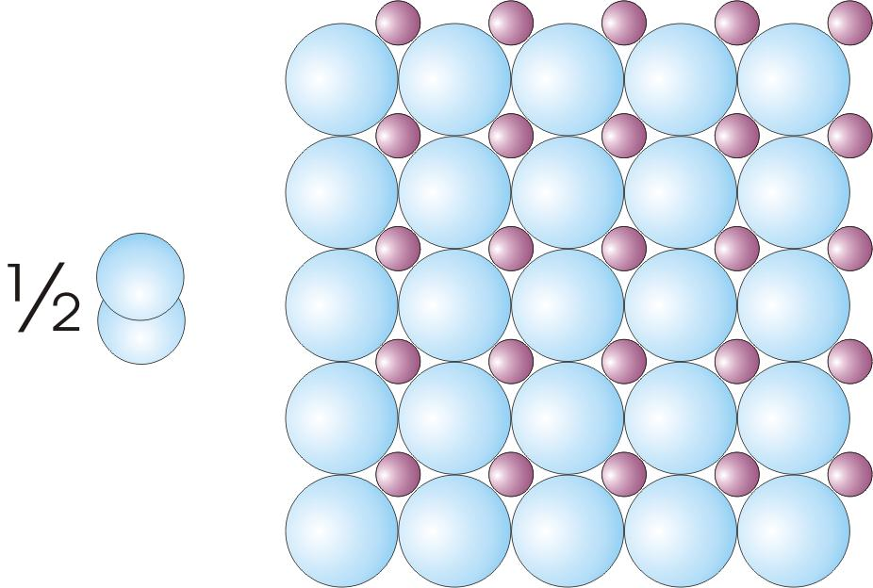
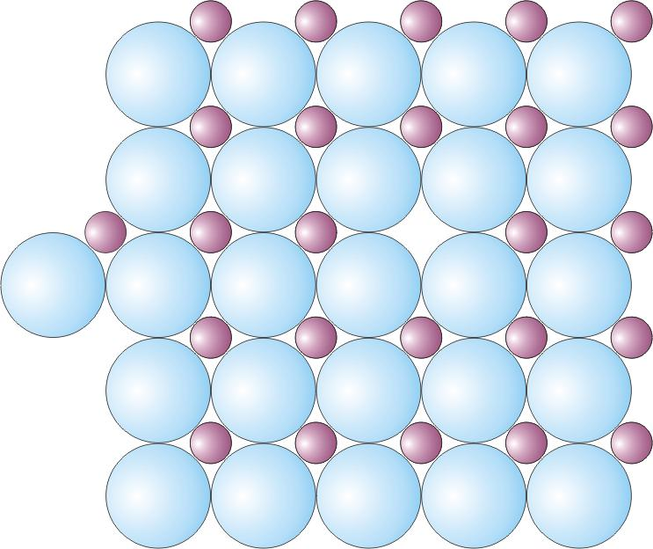
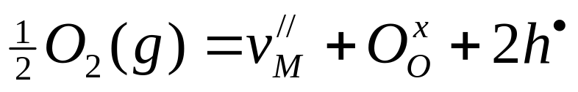
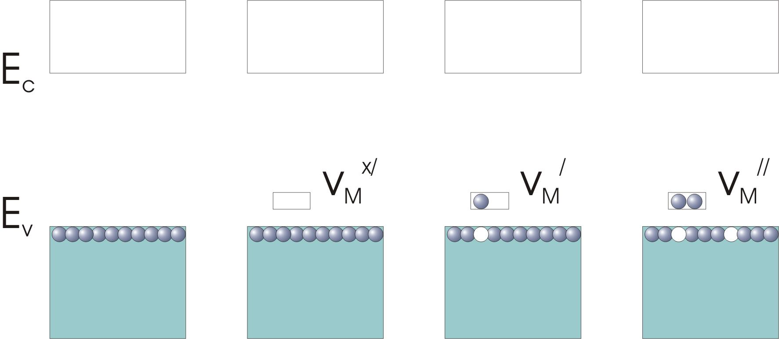
Metal deficiency
Metal vacancies, example MO - M_{1-x}O
The metal vacancy is an acceptor

Slide 25
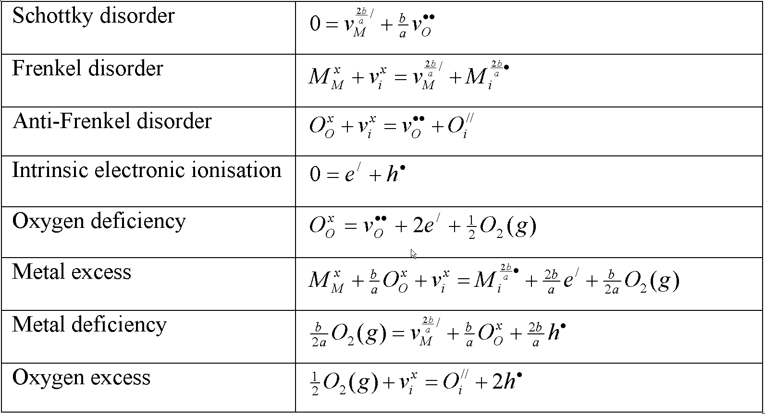
Summmary of fundamental defect reactions for fully ionised point defects for oxides M_{a}O_{b}

Slide 26
Defect reactions for elemental solids
For metals, vacancies and interstitials can form, but are not charged.
For semiconducting elements, vacancies and interstitials can accept or donate electrons, although the ionisation is not as favourable as in ionic compounds.
  Vacancies have a tendency to accept electrons
  Interstitials have a tendency to donate electrons
  i.e. they behave similar to the metal component in an ionic compound

Slide 27
Defect reactions involving foreign elements

Slide 28
Foreign elements; some terminology
Foreign elements are often classified as
  impurities – non-intentionally present
  dopants – intentionally added in small amounts
  substituents – intentionally substituted for a host component
  (we tend to call it all doping and dopants)
They may dissolve interstitially or substitutionally
Substitutionally dissolved foreign elements may be
  homovalent – with the same valency as the host it replaces
  heterovalent – with a different valency than the host it replaces.
    Also called aliovalent
    Heterovalent metals
      Higher valent metals will sometimes be denoted Mh (h for higher valent).
      Lower valent metals will sometimes be denoted Ml (l for lower valent).

Slide 29
Doping of semiconductors
In covalently bonded semiconductors, the valence electrons will strive to satisfy the octet rule for each atom.
As example, we add P or B to Si.
Si has 4 valence electrons and forms 4 covalent bonds.
Phosphorous P has 5 valence electrons. When dissolved in the Si structure it thus easily donates its extra electron to the conduction band in order to become isoeletronic with Si.
Boron B has 3 valence electrons. When dissolved in the Si structure it thus easily accepts the lacking electron from the valence band in order to become isoeletronic with Si.

Slide 30
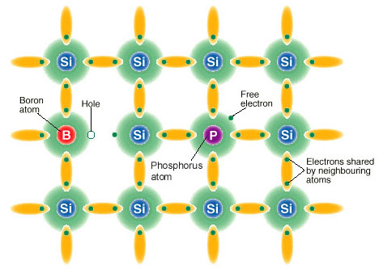
Doping of semiconductors

Slide 31
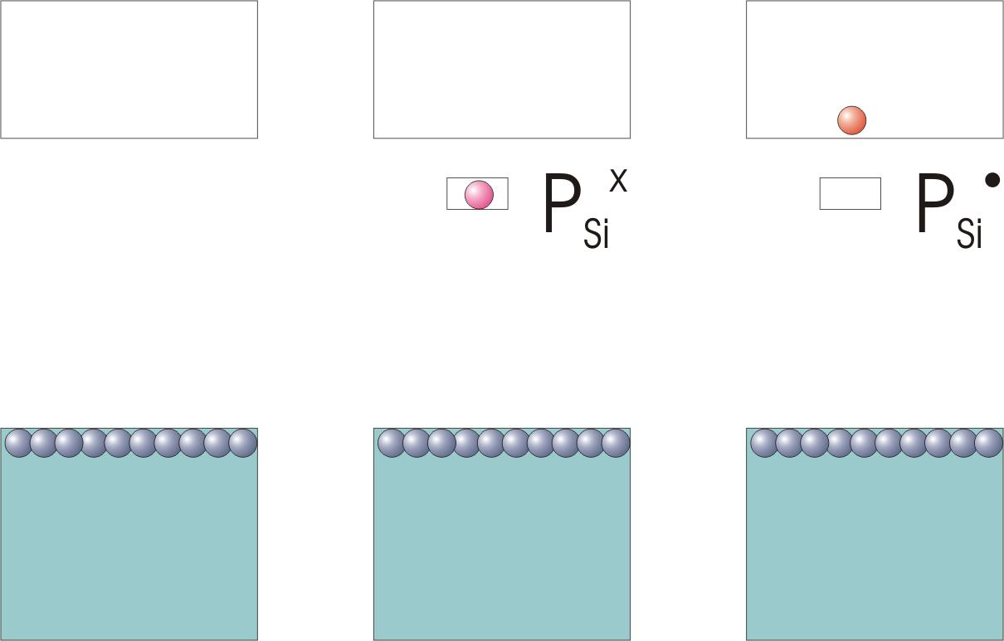
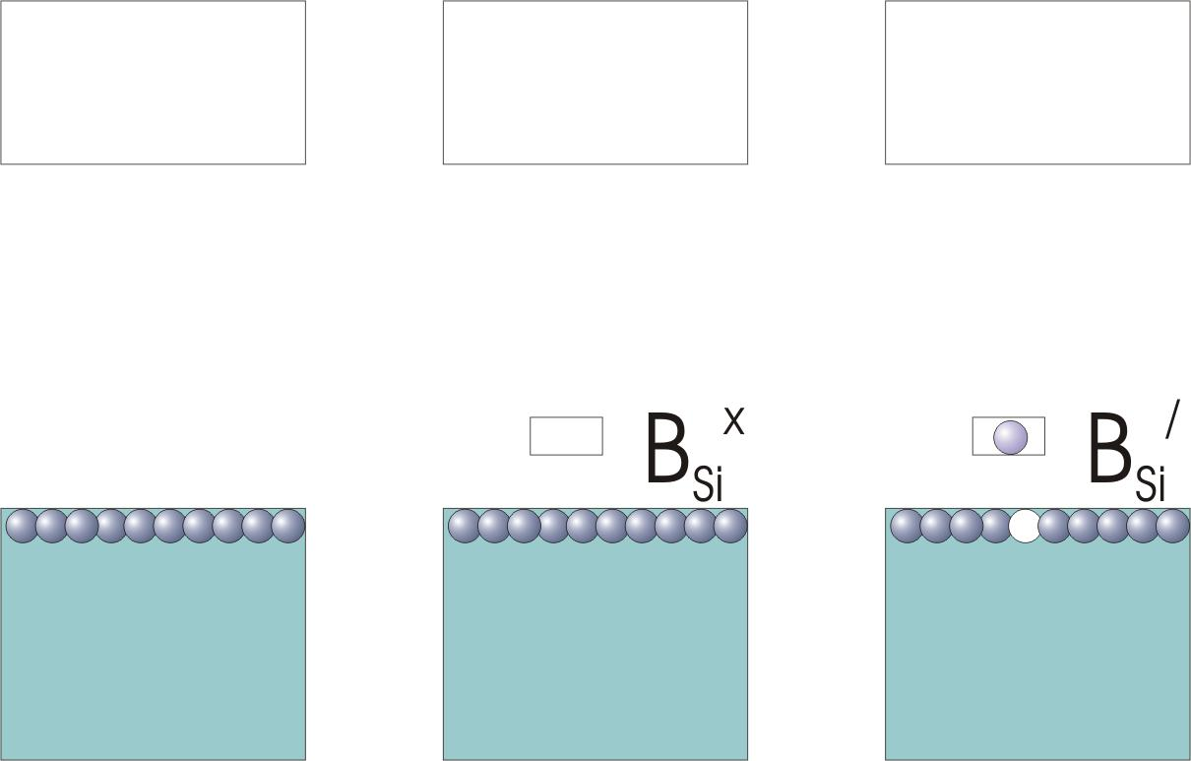
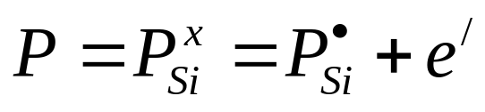

Doping of Si with P (donor) or B (acceptor)

Slide 32
Doping of ionic compounds
In ionic compounds, the atoms will ionise to reach their stable formal oxidation number.
We shall as examples first look at the doping of some binary oxides.
When writing a doping reaction that introduces effectively charged dopants, we must compensate the charge to fulfill charge conservation.
  We can do that by forming defects of opposite effective charge or consuming defects of the same effective charge.
  As always in chemistry, you can write any reaction you like as long as it satisfies the rules. But it may or may not be an important reaction.
  It mainly makes sense to consume or form defects that are already there in dominating amounts in the undoped material.
  Moreover, it makes more sense to write the reaction that forms charge compensating defects than to consume defects, because the consumption is only effective for limited amounts of doping. The formation of new defects can follow to large doping concentrations.

Slide 33
Doping of ionic compounds, cont’d
Write the reaction as you imagine you would do the doping during synthesis:
  Start with the dopant oxide in its stable oxidation state.
  If it dissolves interstitially, the reaction is trivial.
  If it dissolves substitutionally,
    let it form the sites it needs in the host structure as part of the reaction
    or
    let the host structure be present and then substitute it as needed. This may be more intuitive, but involves more material….
  Simplify by cancelling equal entries; the two approaches for substitution then come out the same.
The site ratio conservation rule applies to the host structure,
not to the dopant oxide!

Slide 34


M_{1-x}O doped substitutionally with Mh₂O₃
Mh³⁺ substituting M²⁺ will constitute donor-doping, giving effectively positive dopants.
M_{1-x}O contains M vacancies and electron holes.
The doping may thus be compensated by producing M vacancies:
or – less relevant - by consuming electron holes. This is a reduction reaction and releases oxygen:

Slide 35


Ni_{1-x}O doped substitutionally with Li₂O
Li⁺ and Ni²⁺ are similar in size, so Li⁺ may substitute Ni²⁺. This will constitute acceptor-doping with effectively negative dopants. (This is utilised in Li-doped NiO for p-type conducting electrodes for fuel cells, batteries etc.)
Ni_{1-x}O contains nickel vacancies and electron holes.
The doping may thus be compensated by consuming Ni vacancies
or – better - by producing electron holes. This is an oxidation reaction and requires uptake of oxygen

Slide 36

ZrO_{2-y} doped substitutionally with Y₂O₃
Y³⁺ will form effectively negative defects when substituting Zr⁴⁺ and thus acts as an acceptor. It must be compensated by a positive defect.
ZrO_{2-y} contains oxygen vacancies and electrons
The doping is thus most relevantly written in terms of forming oxygen vacancies:

Slide 37



ZrO_{2-y} doped substitutionally with Y₂O₃
Note: Electrons donated from oxygen vacancy accepted by Y dopants; no electronic defects in the bands.

Slide 38


Hydrogen and protons in oxides
The H are dissolved interstitially. They are donors and are easily ionised to protons H⁺
Protons H⁺ immediately form hydroxide OH⁻ ions with the host oxide O²⁻ ions.
Reaction written in steps:

Slide 39



Hydration – dissolution of protons from H₂O
Water as source of protons. Equivalent to other oxides as source of foreign elements.
Example: Hydration of acceptor-doped MO₂, whereby oxygen vacancies are annihilated, and protons dissolved as hydroxide ions.
The acceptor dopants are already in, and are not visible in the hydration reaction in this case

Slide 40


Ternary and higher compounds
With ternary and higher compounds the site ratio conservation becomes a little more troublesome to handle, that’s all.
For instance, consider the perovskite CaTiO₃. To form Schottky defects in this we need to form vacancies on both cation sites, in the proper ratio:
And to form e.g. metal deficiency we need to do something similar:
(But oxygen deficiency or excess would be just as simple as for binary oxides, since the two cations sites are not affected in this case ☺…)

Slide 41


What if a ternary oxide has a strong preference for one of the cation defects?
It can choose to make a selection of the defects by throwing out one of the components, in order to not brake the site ratio conservation rule.
Example: Schottky defects in ABO₃ with only A and O vacancies:
Example: Oxidation of ABO₃ by forming metal deficiency only on the A site:
Note: Choice of AO(s) (secondary phase) or AO(g) (evaporation) are arbitrarily hosen to illustrate the possibilities…

Slide 42
Doping of ternary compounds
The same rule applies: Write the doping as you imagine the synthesis is done: If you are doping by substituting one component, you have to remove some of the component it is replacing, and thus having some left of the other component to react with the dopant.
For instance, to make undoped LaScO3, you would probably react La₂O₃ and Sc₂O₃ and you could write this as:
Now, to dope it with Ca²⁺ substituting La³⁺ you would replace some La₂O₃ with CaO and let that CaO react with the available Sc₂O₃:
The latter is thus a proper doping reaction for doping CaO into LaScO₃, replacing La₂O₃.

Slide 43
Concluding remarks
You have learned the three rules of writing correct defect chemical reaction equations: Mass, charge, and site ratio conservation.
You can write any defect chemical reaction you like.
  but some are more useful and relevant than others
  You have become familiar with many of them, and through that also more familiar with many defects and defect combinations (often pairs).
  We have not emphasised it, but good defect reactions restrict themselves to fewest possible defects – don’t add reactions so that you form two or more pairs in parallel.
We have provided schematic atomistic pictures of what goes on to aid in your comprehension of formation of the defects
In addition to writing correct reactions, you have in this presentation gotten insight into energy considerations related to electrons and holes ionisation of defects. This relates to their behaviour as donors and acceptors.

